Slide 1
Conservation of Linear Momentum
The conservation of linear momentum states that the total linear momentum of a system is conserved whenever there are no external forces acting on the system.
u₁
u₂
v₁
v₂
F
F
m₁
m₂
m₁
m₂
Before collision
During collision
After collision
m₁u₁ + m₂u₂ = m₁v₁ + m₂v₂
Total momentum before collision = Total momentum after collision

Slide 2
Using Newton’s Third Law
Whenever two solid objects are in contact they exert equal and opposite forces on each other.
Consequently they exert equal and opposite impulses on each other
Since change in momentum is equal to the impulse which produce the change
The resultant change in momentum of the two objects is therefore zero.
Their total momentum remains constant although internal forces have affected the motion of both objects.

Slide 3
Inelastic and Elastic Collisions
Inelastic collision
The particles coalesces after collision.
  The momentum are conserved
  The Kinetic energy are not conserved.
Elastic collision
  The momentum are conserved.
  The kinetic energy are not conserved for partial elastic collision
  The kinetic energy are conserved for perfectly elastic collision.

Slide 4
Collision between two bodies

Slide 5
Example 1 A body of mass 2 kg moving on a smooth horizontal surface at 3ms⁻¹, collides with a second body of mass 1 kg which is at rest. After the collision the bodies coalesce. Find the common speed of the bodies after impact.

Slide 6
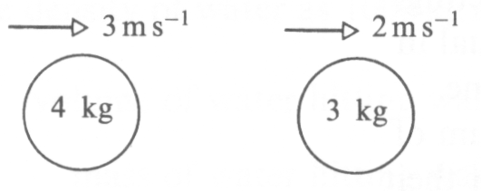
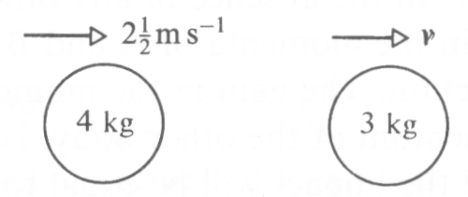
Example 2 The two bodies shown collide on a smooth horizontal surface. Find the value of v, the speed of the lighter body after impact.
before collision
after collision

Slide 7
Eg3. A body of mass m, is traveling with speed 2u when it collides with a body of mass 3m traveling in the opposite direction with speed u. If the impact reduces the second body to rest, what will be the speed of the first body after impact?
2u
u
v₁
0
m
3m
m
3m
Before collision
After collision

Slide 8
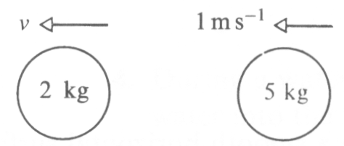
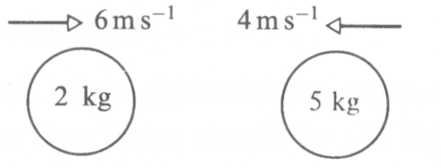
Example 4 The two bodies shown collide on a horizontal surface. Find the speed v of the lighter body after impact.
before collision
after collision

Slide 9
Loss of energy
When bodies collide, there is no loss of momentum
but there is a loss of kinetic energy.
Some of the kinetic energy possessed by the bodies is transformed into other forms of energy at the impact, e.g. heat and sound energy.

Slide 10
Example 5 Two smooth spheres A and B, of masses 150g and 350 g, are traveling towards each other along the same horizontal line with speeds of 4ms⁻¹ and 2ms⁻¹ respectively. After the collision, the direction of motion of B has been reversed and it is traveling at a speed of 1 m s⁻¹. Find the speed of A after the collision and the loss of kinetic energy due to the collision.

Slide 11
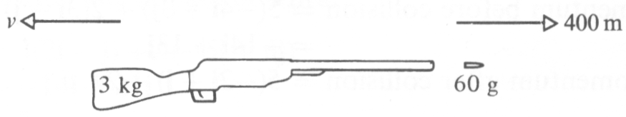
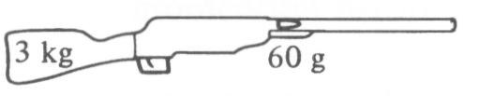
Example 6 A bullet is fired from a gun with a horizontal velocity of 400ms ⁻¹. The mass of the gun is 3 kg and the mass of the bullet is 60 g. Find the initial speed of recoil of the gun and the gain in the kinetic energy of the system.
before explosion
after explosion
both gun and shot at rest

